Slide 1

Reputation helps Solve the ‘Tragedy of Commons’
Manfred Milinski, Dirk Semmann & Hans-Jurgen Krambeck
Presented and Reviewed by:
Anmol Sureshkumar Panchal

Slide 2

Road Map
Motivation
Strengths
Weaknesses
Extensions
Goal
Method
Results & Conclusions

Slide 3

Motivation
To sustain a public resource from overuse leads to ‘tragedy of commons’.
Self Interest vs Public Interest.
Cooperation to sustain as a group or as an individual.
Reputation (image score) can be a currency which leads to cooperation and interaction between individuals.

Slide 4
Goal
To simulate Indirect reciprocity and Public goods problem.
Prove the hypothesis that interaction with the indirect reciprocity game keeps up the cooperation in public goods game.
To address the problem of ‘Tragedy of Commons’

Slide 5



Method:- Indirect reciprocity
Players are anonymous and assigned a pseudo name.
Simulation was done for 20 rounds.
Subjects are partitioned by opaque partitions.
Communicated decisions with silent(piezo) switches.
A person can be a potential donor or receiver.
Subject/Amount | A | B
Y | -2.50 loss (donor) | 4.0 gain (receiver)
N | No loss | No gain
Y/N
A
B
Image score of A reduces, leads to less chance to become a Potential Reciever

Slide 6
Method:- Public Goods
All players asked to Contribute DM 2.50 to public pool.
Display Decision and status of contribution (Y/N) on screen for 20 s.
Contents in pool will be doubled and redistributed to everyone.

Slide 7

Method:- Model for Public Goods
All are given $5.
Without any Discussion contribute x ; where $0< x <=$5
Experimenter will add total amount from contribution of four players and double it and redistribute it to them equally.
Players | Initial Amount | Contribution | Amount after contribution | Worse Situation | Best Situation
P | $5 | $3 | $4 | $1 | $5
Q | $5 | $2 | $4 | $1 | $5
R | $5 | $2 | $4 | $1 | $5
S | $5 | $1 | $4 | $1 | $5
 | $20 | $8 | $16 | $4 | $20
P
S
Q
R

Slide 8
Method:- Model for Testing Indirect Reciprocity with Public Goods
114 participants, 19 Groups of 6 subjects
Initially they have DM 20($10)
The game will be played in two different situations: Public goods and Indirect reciprocity.
10 groups played 1 round of Indirect Reciprocity and then 1 round of Public goods until round 16.
Then, every second group plays only public goods from round 17
9 other groups played 8 rounds of public goods followed by 8 rounds of Indirect reciprocity.
Again , every second group plays only public goods from round 17

Slide 9
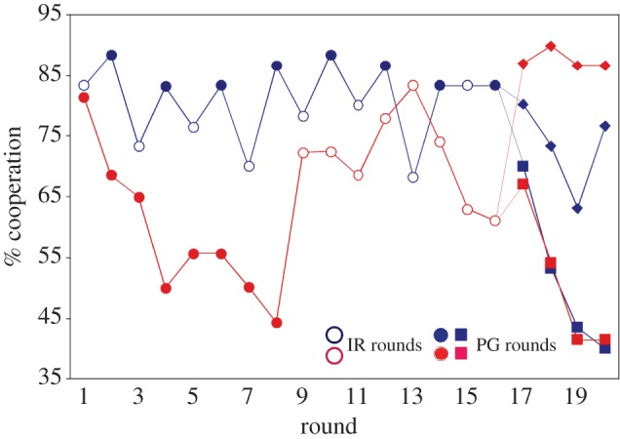
Results
Groups with 8 rounds of PG initially the cooperation declined.
Cooperation was re-established when IR comes into play.
The groups where PG & IR was played in alternate fashion, cooperation did not declined and was considerably higher than that of 9 other groups.
Payoffs seen were high in Alternating game then Non-alternating game.
Probability of receiving ‘no’ in IR round was high when PG(pre.) = NO and low for PG(pre.) =YES
https://www.nature.com/nature/journal/v415/n6870/pdf/415424a.pdf?origin=ppub

Slide 10
Conclusions
The probability of receiving ‘no’ in IR game was significantly higher for players that had refused to give in the preceding PG round than those who had given.
Interaction between IR game keeps up the cooperation in PG game which is tested by 4 rounds( 17-20) of PG played by groups.
Cooperation was maintained when IR is not excluded.
Refusing to give, affects the player’s reputation (image score) and also influenced the same in other rounds.
In IR , player were refused to give to someone with low image score.
The tragedy of commons was no longer a tragedy as cooperation was seen when PG & IR were alternated among groups and the commons became productive.

Slide 11
Strength 1
This paper revolves around IR and its Reputation (image score) which is distinguished feature from other papers.
As other papers discussed about (1) assign ownership, (2) divide the resources & (3)External rules and policies
This paper took ‘Reputation’ as a tool to solve the problem of ToC without affecting the control over common resources.

Slide 12
Strength 2
They smartly introduced PG rounds again from round 17-20.
This showed interaction in IR helped to foster Cooperation in PG.
The same individuals interacted in more cooperative manner.
It helped them to sense benefits of cooperation and try to
become cooperative to sustain themselves.
PG rounds 1-8 and 17-20
https://www.nature.com/nature/journal/v415/n6870/pdf/415424a.pdf?origin=ppub

Slide 13
Strength 3
This paper was Concise.
As a researcher you do not need to add a lot to the research paper to make it unique or interesting rather you should add only relevant and original content.
The readers will be able to understand a concise research more easily, there should not be unnecessary details in the research.
Example:- The researcher can write details and lots of explanations but these details and explanations should be of value to the research the researcher should not add unnecessary details in the research.

Slide 14
Weakness 1
They had constant parameters.
They can vary same participants with more or less number of rounds or vary amount of participants.
This will generate some interesting patterns to analyze whether IR is able to foster Cooperation levels in PG in such combinations.

Slide 15
Weakness 2
They suffer the question of Scalability…
Since cooperation is difficult when there are exponentially large number of participants(real world problems) then in limited 114 participants.

Slide 16
Weakness 3
Reputation is not equally valuable for everyone.
What if some group of people did not value the reputation score and still interact with low image score individuals.
The results then would be more interesting to analyze and compare PG & IR and its effectiveness towards solving ToC.

Slide 17
Extension 1
Scale this problem to real world social dilemma and see whether we can get similar results or not.
The data they used is too small when compared to real world problems.
This can lead us where we can say PG & IR would behave same if it is tested on real world social dilemmas where level of cooperation is hard to sustain.
Results may be complex then they appear here.

Slide 18
Extension 2
If Reputation score was not everything.
If groups were assigned variable sensitivity to reputation score.
Then results would be more interesting to observe and analyze.
May be we would get cluster of groups with common donors/receivers which may be directly or indirectly connected to same individual.
This can demonstrate more accurate results of cooperation levels between all the individuals.

Slide 19
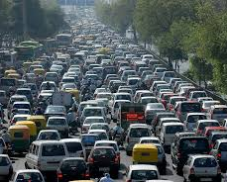
Extension 3
Traffic Congestion can be seen as Public Goods problem.
Government tries to encourage use of public transport and ask to share vehicles (pooling) which can reduce the traffic jams and also the amount of pollution produced.
Here Government acts as Instructor/Examiner who ask for contributions from all its concerned players and which will result in equal benefits to everyone.

Slide 20
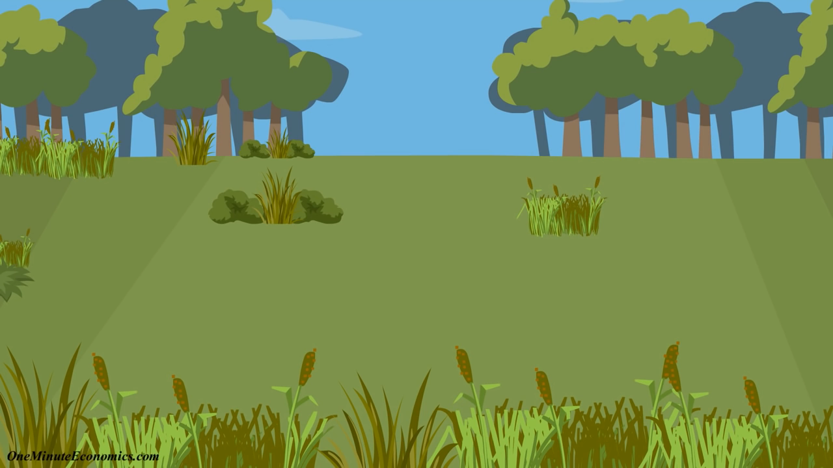
Tragedy of Commons in Brief

Slide 21
Thank You!!! ?

